Slide 1
Web Architecture and Software Development Process
Ishwor Sapkota
Deerwalk

Slide 2
Introduction
Two Section
Section I: Web Architecture
Section II: Software Development Process

Slide 3
Section I: Web Architecture
Introduction
Web architecture is structuring a web site/application to achieve business goal.
It is an approach to design a web site. Web architecture may vary with business need.
It is also the channel to communicate between client and server. i.e. Information flow from user’s computer to database server and back to user’s computer.

Slide 4
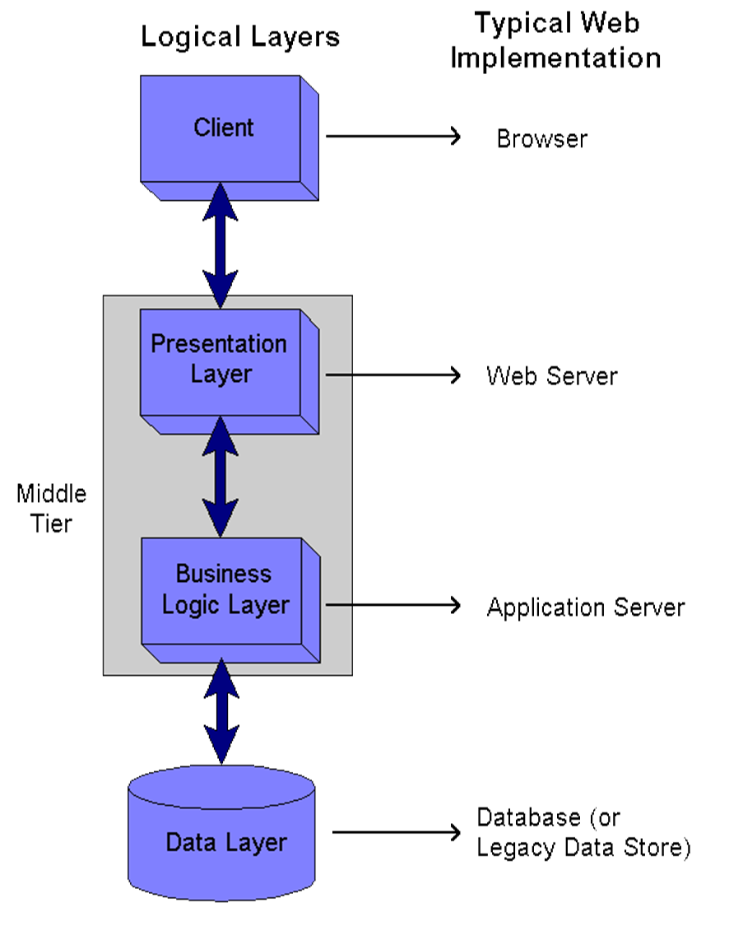
Client Layer
Display data, User insert/update data
Browser
Presentation Layer
Display dynamic content from database
Programming code
Microsoft IIS, Apache Webserver
Business Logic Layer
Calculation, evaluation, validation
Programming code
Application server, Amazon server
Data Layer
Managing data
Procedure, view, table, function
Relational database
Belongs to Business Logic Layer

Slide 5
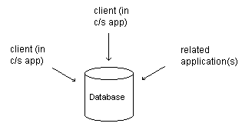
Multi-Tier Architectures
2-Tier Model
Presentation Layer or User interface
Database

Slide 6
Multi-Tier Architectures
3 - Tier Architecture
Presentation Layer or User interface
Business Logic Layer or Web Service
Data Access Layer
User
interface
Web/Database
(Server)
Database
(Server)

Slide 7
Multi-Tier Architectures
N- Tier Architecture
Presentation Layer
Reporting Tools
Client file
Internet file
Business Logic Layer
Web Service
Bulk data processing
Data Layer
Scheduled Procedure/ SQL job
Reporting Server

Slide 8
Why Tier System?
Centralized data server hence multiple application can work on that
Multiple Tier means separate physical layer; hence separate hardware; which allow us to faster processing
Can handle large number of user. (e.g. 1 million click per second)
With independent layer, platform switch is easier (i.e. from .Net to java)

Slide 9
Software Development Process
How software project start?
Different phases
Requirement Analysis, SOW
Mock Up creation and client demo, approval
Architecture design, choice of platform
Team formation
Development and Testing
Bug fixing
Release
QA ,UAT ,Production
Implementation
Support and Feature

Slide 10
Software Development Practices in Deerwalk
Project: Compass
Requirement Doc, Client Call
Time, work hours Estimation
Work division
Development
Testing
Push to production
QA Release note

Slide 11
Thanks

